Slide 1
Stem cells
Adult Stem Cells

Slide 2
Adult STEM CELLS
The history of research on adult stem cells began about 60 years ago. In the 1960s, researchers discovered that the bone marrow contains at least two kinds of stem cells. One population, called hematopoietic stem cells, forms all the types of blood cells in the body. A second population, called bone marrow stromal cells, was discovered a few years later.
Stromal cells are mixed cell population that generates bone, cartilage, fat, and fibrous connective tissue.

Slide 3
Where are adult stem cells found and what do they normally do?
An adult stem cell is an undifferentiated cell found among differentiated cells in a tissue or organ, can renew itself, and can differentiate to yield the major specialized cell types of the tissue or organ.

Slide 4
Where adult stem cells are found?
Adult stem cells have been identified in many organs and tissues. However, there are a very small number of stem cells in each tissue.
Stem cells are thought to reside in a specific area of each tissue where they may remain quiescent (non-dividing) for many years until they are activated by disease or tissue injury.
The adult tissues reported to contain stem cells include brain, bone marrow, peripheral blood, blood vessels, skeletal muscle, skin and liver.

Slide 5
Role of adult stem cells
The primary role of adult stem cells in a living organism are to maintain and repair the tissue in which they are found.
Some scientists now use the term somatic stem cell instead of adult stem cell. Unlike embryonic stem cells, which are defined by their origin (the inner cell mass of the blastocyst), the origin of adult stem cells in mature tissues is unknown.

Slide 6
What are the tests used for identifying adult stem cells?
One or more of the following methods are normally used for the identification of adult stem cells:
  Labeling the cells in a living tissue with molecular markers and then determining the specialized cell types they generate.
  Removing the cells from a living animal, labeling them in cell culture, and transplanting them back into another animal to determine whether the cells repopulate their tissue of origin
  Isolating the cells, growing them in cell culture, and manipulating them, often by adding growth factors or introducing new genes, to determine what differentiated cells types they can become.

Slide 7
A single adult stem cell should be able to generate a line of genetically identical cells—known as a clone—which then gives rise to all the appropriate differentiated cell types of the tissue.
Adult stem cells may exhibit two types of differentiation pathways;
  Normal differentiation; to form specialized cell types of the tissue in which they reside.
  Trans-differentiation or plasticity; cells may also exhibit the ability to form specialized cell types of tissues other than the place where they reside.

Slide 8
Normal Differentiation
The following are examples of differentiation pathways of adult stem cells (Figure 1).
  Hematopoietic stem cells give rise to all types of blood cells: red blood cells, B lymphocytes, T lymphocytes, natural killer cells, neutrophils, basophils, eosinophils, monocytes, macrophages, and platelets.
  Bone marrow stromal cells (mesenchymal stem cells) give rise to a variety of cell types: bone cells (osteocytes), cartilage cells (chondrocytes), fat cells (adipocytes), and other kinds of connective tissue cells such as those in tendons.

Slide 9
  Neural stem cells in the brain give rise to its three major cell types: nerve cells (neurons) and two categories of non-neuronal cells- astrocytes and oligodendrocytes.
  Epithelial stem cells in the lining of the digestive tract occur in deep crypts and give rise to several cell types: absorptive cells, goblet cells, Paneth cells, and entero-endocrine cells.
  Skin stem cells occur in the basal layer of the epidermis and at the base of hair follicles. The epidermal stem cells give rise to keratinocytes, which migrate to the surface of the skin and form a protective layer. The follicular stem cells can give rise to both the hair follicle and to the epidermis.

Slide 10
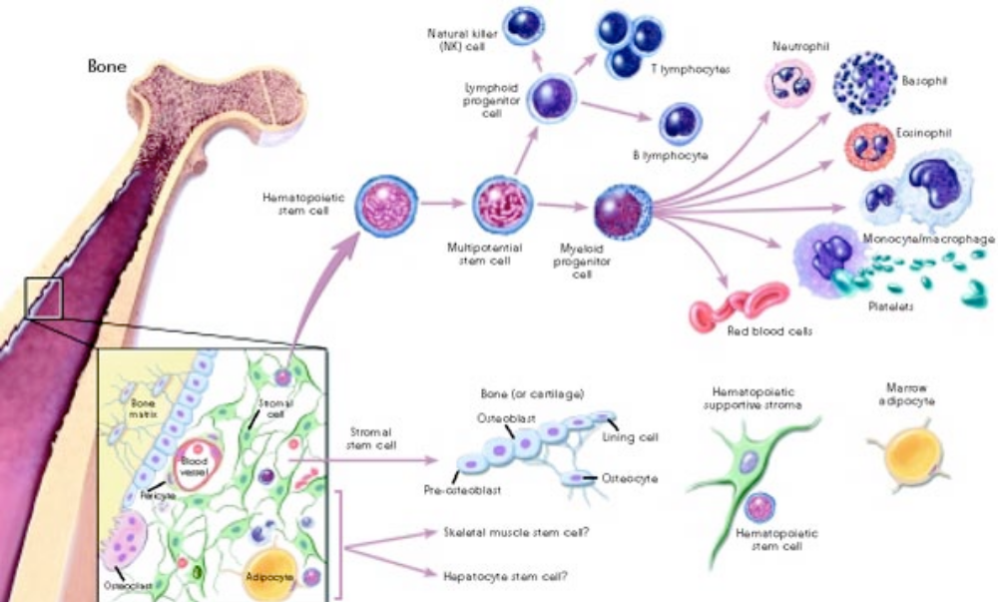

Slide 11
Trans-differentiation or plasticity of adult stem cells
Certain adult stem cell types are pluripotent. This ability to differentiate into multiple cell types is called plasticity or trans-differentiation.
The following list offers examples of adult stem cell plasticity that have been reported during the past few years (Figure 2).
Hematopoietic stem cells may differentiate into:
  three major types of brain cells (neurons, oligodendrocytes, and astrocytes)
  skeletal muscle cells
  cardiac muscle cells
  liver cells.
Bone marrow stromal cells may differentiate into: cardiac muscle cells and skeletal muscle cells.
Brain stem cells may differentiate into: blood cells and skeletal muscle cells.

Slide 12
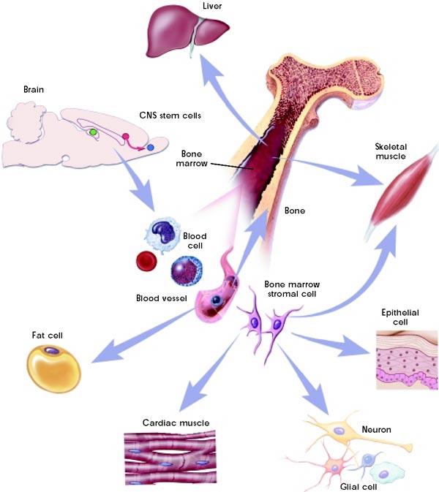


Slide 13
What are embryonic stem cells?
Are derived from embryos originated from eggs that have been fertilized in vitro in an in vitro fertilization clinic and donated to research institutions with donors consent.
The embryos from which human embryonic stem cells are derived are typically four or five days old and are a hollow microscopic ball of cells called the blastocyst which includes three parts;
  Trophoblast, which is the layer of cells that surrounds the blastocyst
  Blastocoel, which is the hollow cavity inside the blastocyst
  Inner cell mass, which is a group of approximately 30 cells at one end of the blastocoel.

Slide 14
How are embryonic stem cells grown in the laboratory?
Growing cells in the laboratory is known as cell culture.
Human embryonic stem cells are isolated by transferring the inner cell mass into a plastic laboratory culture dish that contains a nutrient broth known as a culture medium.
The inner surface of the culture dish is typically coated with mouse embryonic skin cells that have been treated so they will not divide. This coating layer of cells is called a feeder layer.

Slide 15
The reason for having the mouse cells in the bottom of the culture dish is to give the inner cell mass cells a sticky surface to which they can attach. In addition, these feeder cells release nutrients into the culture medium.
Over the course of several days, the ESC proliferate and begin to crowd the culture dish.
Cells are removed gently and plated into several fresh culture dishes. The process of replating the cells is repeated many times and for many months, and is called subculturing. Each cycle of subculturing the cells is referred to as a passage.

Slide 16
Embryonic stem cells that have proliferated in cell culture for six or more months without differentiating, are pluripotent, and appear genetically normal and are referred to as an embryonic stem cell line.
Once cell lines are established, or even before that stage, batches of them can be frozen and shipped to other laboratories for further culture and experimentation.

Slide 17
What laboratory tests are used to identify embryonic stem cells?
At various points during the process of generating embryonic stem cell lines, scientists test the cells to see whether they exhibit the fundamental properties that make them embryonic stem cells.
These tests include;
  growing and subculturing the stem cells for many months. This ensures that the cells are capable of long-term self-renewal.

Slide 18
  Scientists inspect the cultures through a microscope to see that the cells look healthy and remain undifferentiated.
  Using specific techniques to determine the presence of surface markers that are found only on undifferentiated cells.
  Another important test is for the presence of a protein called Oct-4, which is typically made by undifferentiated cells. Oct-4 is a transcription factor, helps turn genes on and off at the right time, which is an important part of the processes of cell differentiation and embryonic development.
  Examining the chromosomes under a microscope. This is a method to assess whether the chromosomes are damaged or if the number of chromosomes has changed.

Slide 19
However, microscopy examination of chromosomes, does not detect genetic mutations in the cells.
Determining whether the cells can be subcultured after freezing, thawing, and replating.
Testing whether the human embryonic stem cells are pluripotent by;
  allowing the cells to differentiate spontaneously in cell culture
  manipulating the cells so they will differentiate to form specific cell types
  injecting the cells into an immunosuppressed mouse to test for the formation of a benign tumor called a teratoma.

Slide 20
Teratomas typically contain a mixture of many differentiated or partially differentiated cell types
This is an indication that embryonic stem cells are capable of differentiating into multiple cell types.

